Slide 1

QUANTITATIVE APTITUDE INTEREST, PARTNERSHIP & PROFIT AND LOSS

Slide 2
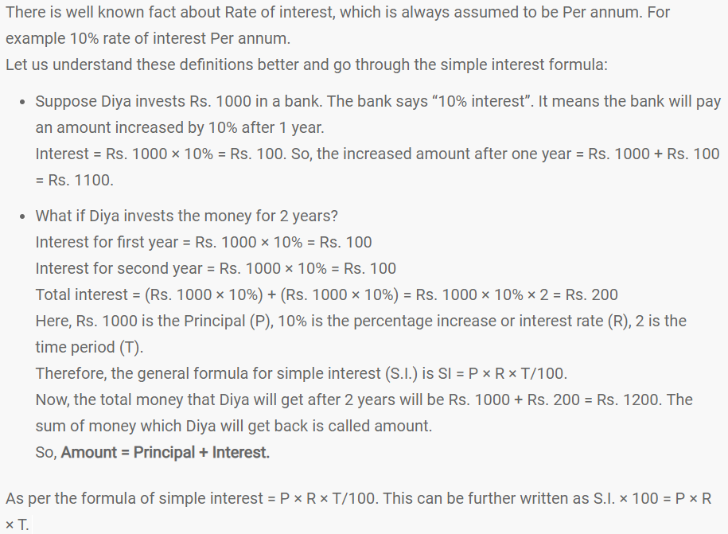
SIMPLE INTEREST

Slide 3
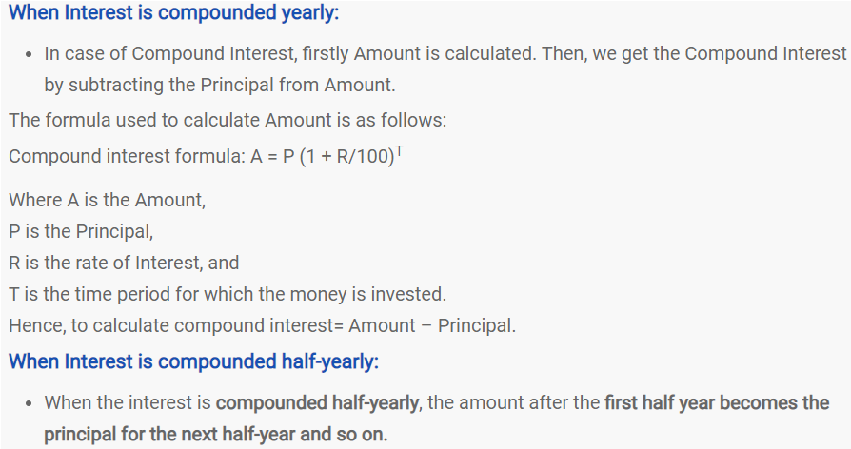
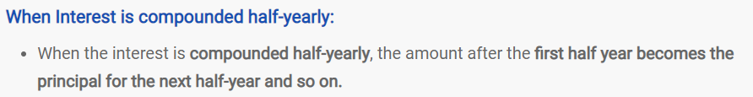
COMPOUND INTEREST

Slide 4
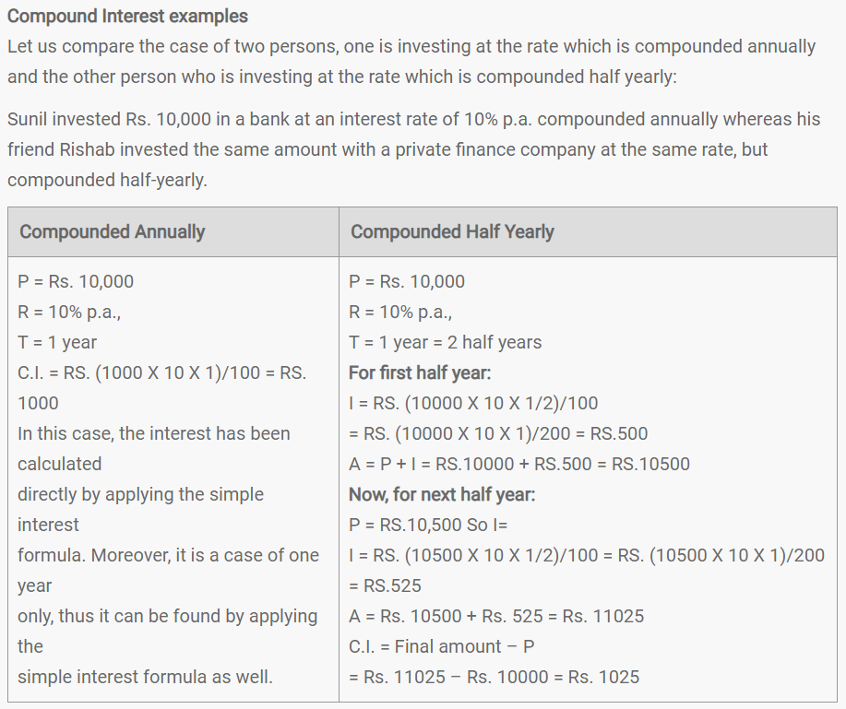

Slide 5
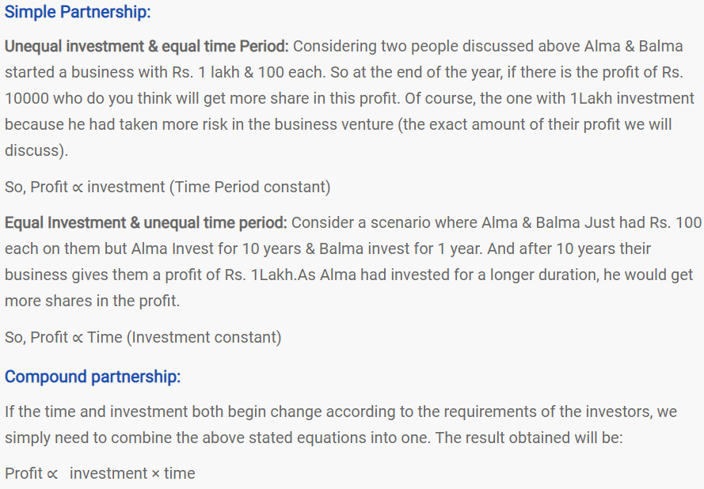
PARTNERSHIP

Slide 6
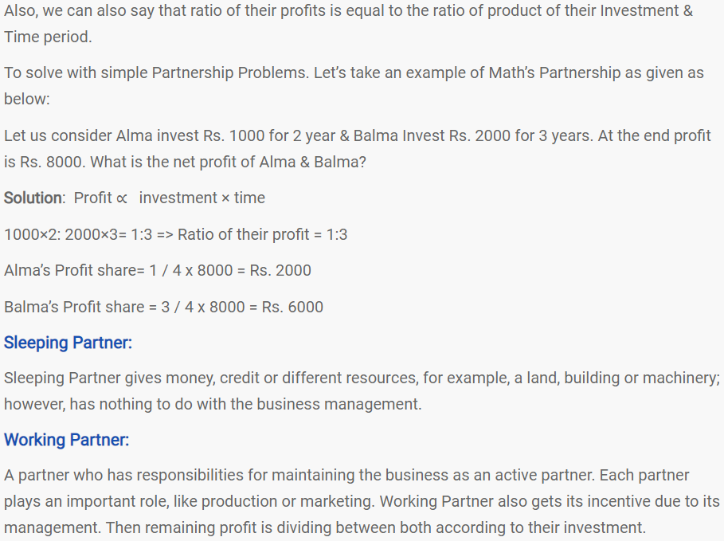

Slide 7
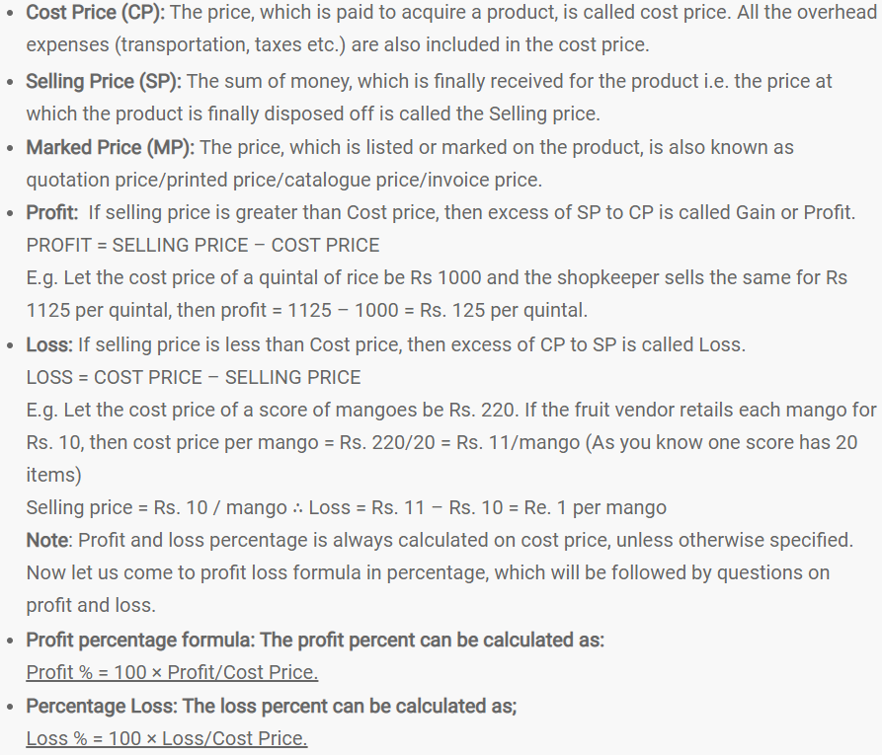
PROFIT
& LOSS

Slide 8
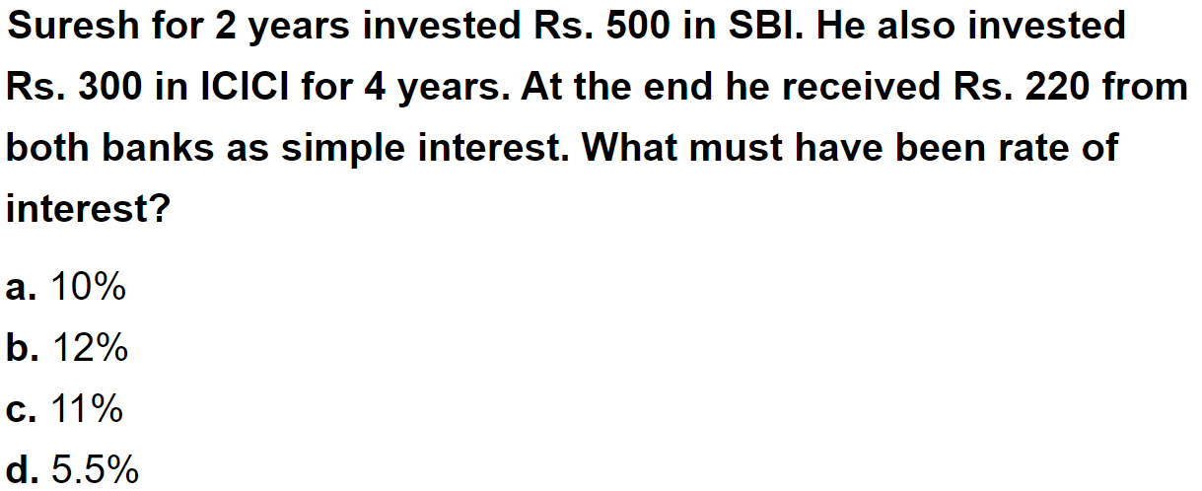
Question No. - 1

Slide 9
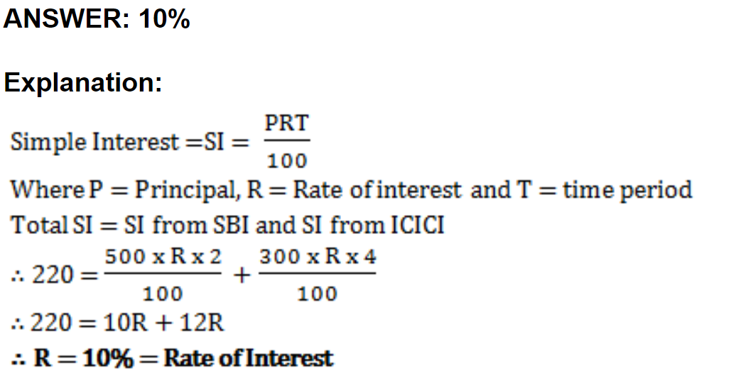

Slide 10
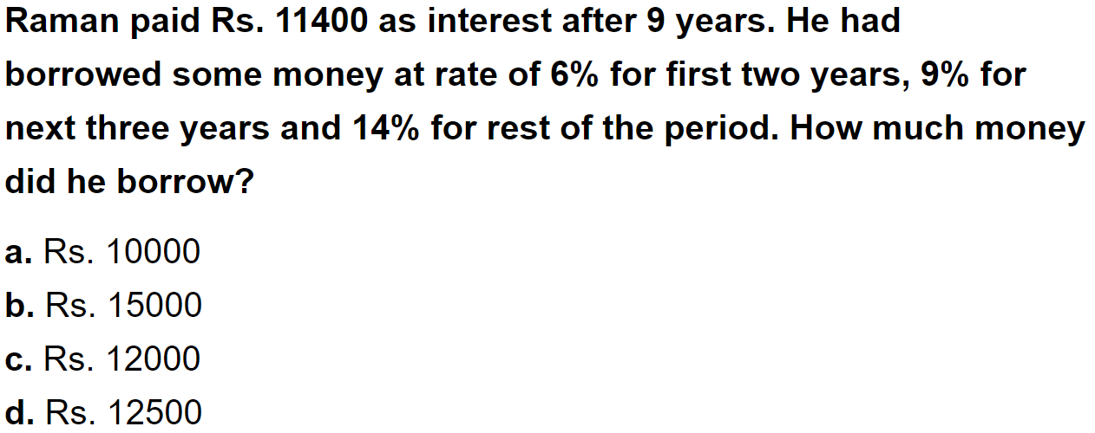
Question No. - 2

Slide 11
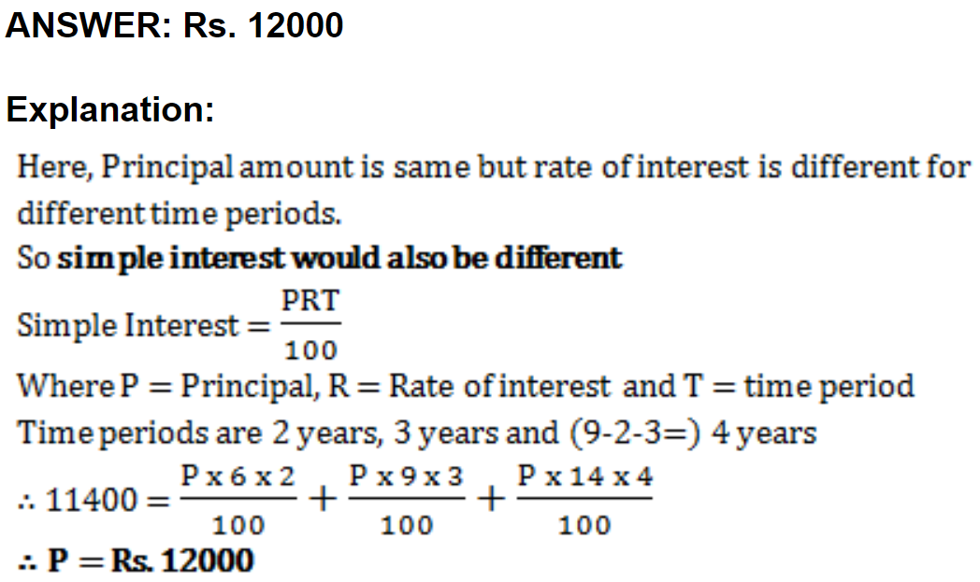

Slide 12
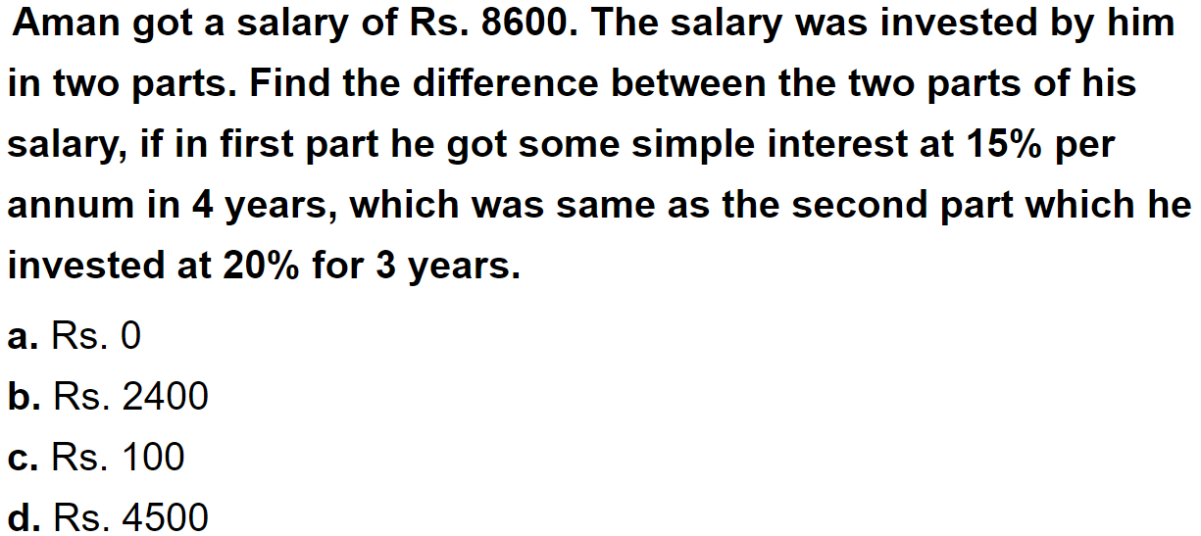
Question No. - 3

Slide 13
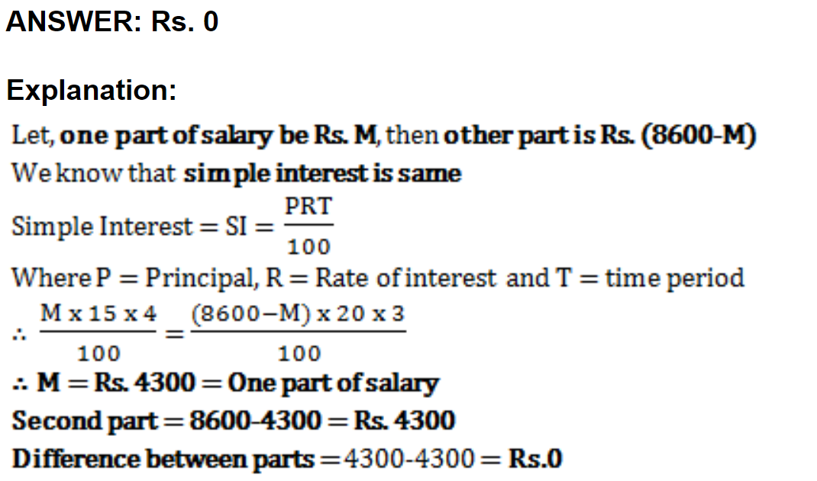

Slide 14
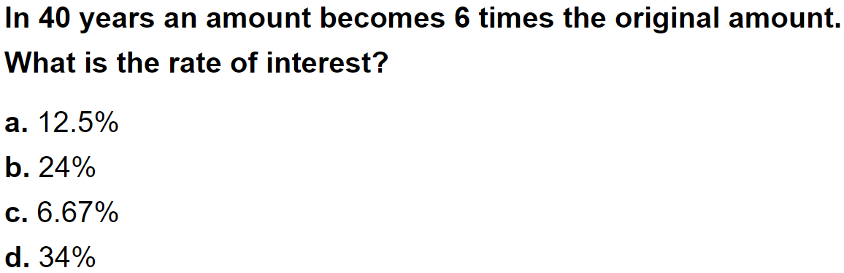
Question No. - 4

Slide 15
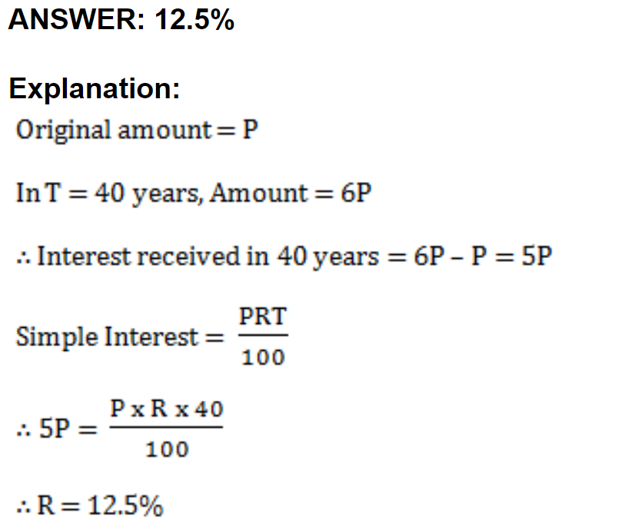

Slide 16
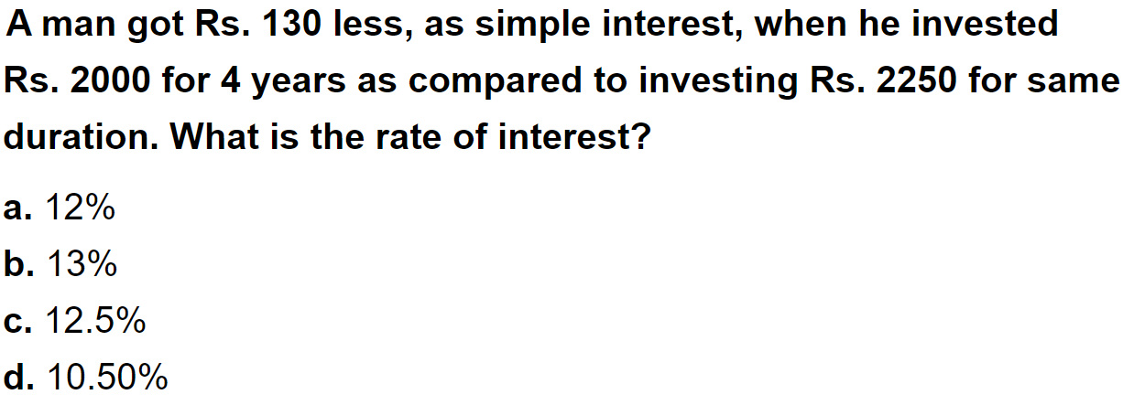
Question No. - 5

Slide 17
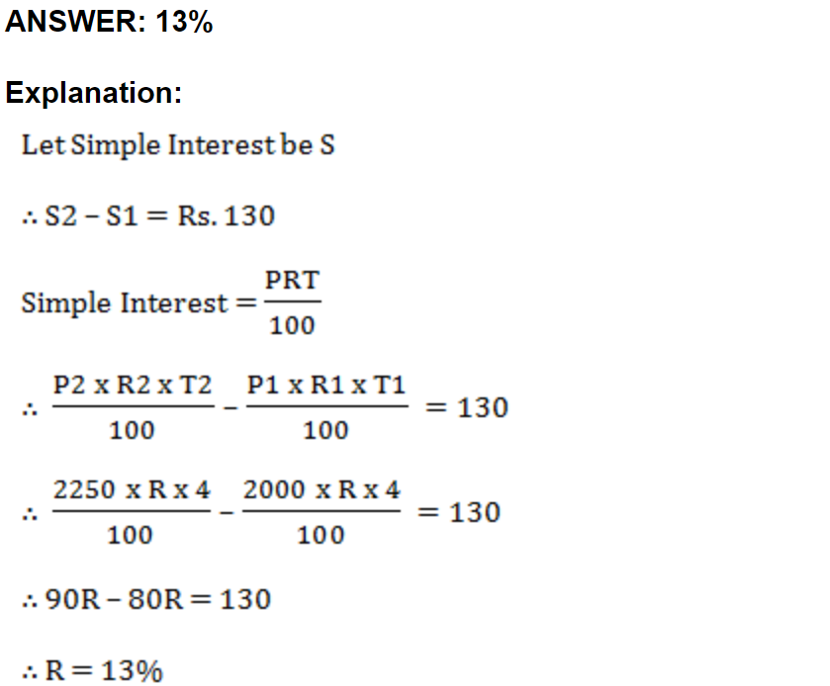

Slide 18
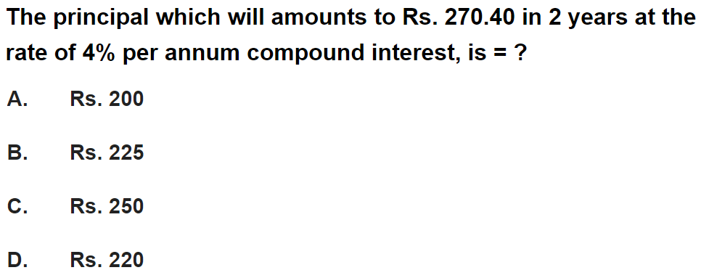
Question No. - 6

Slide 19
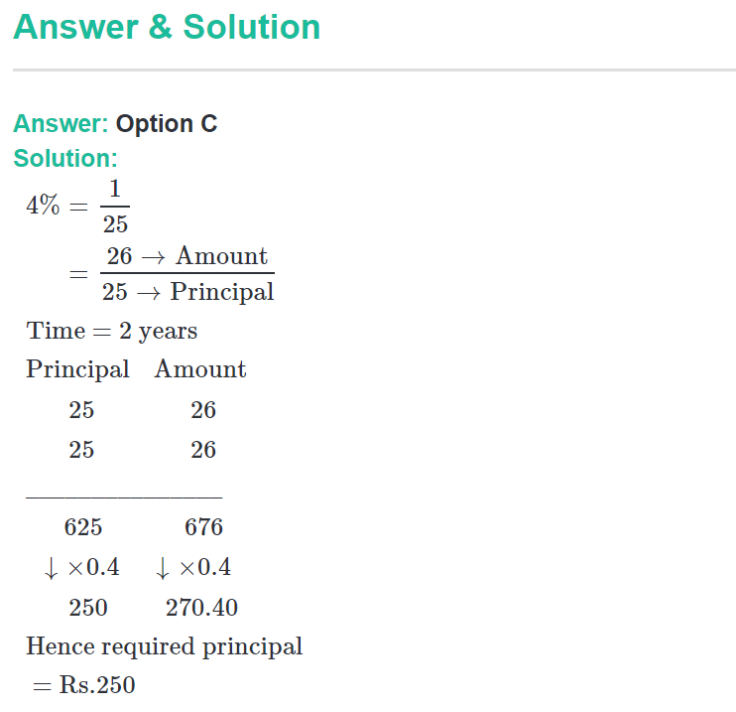

Slide 20
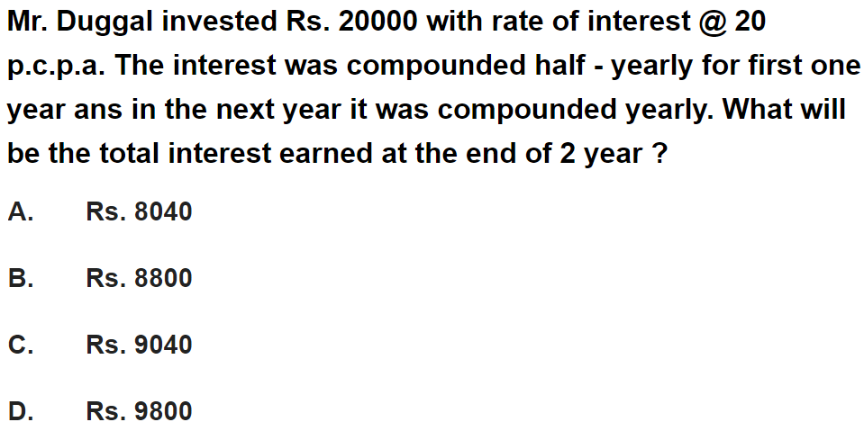
Question No. - 7

Slide 21
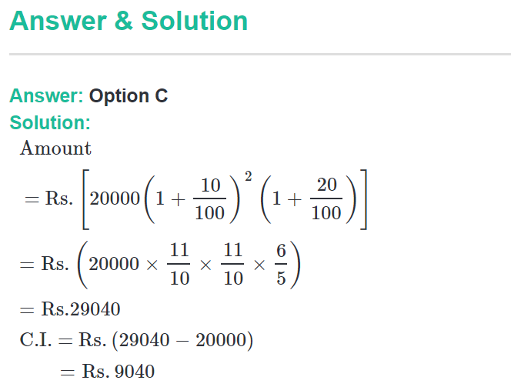

Slide 22
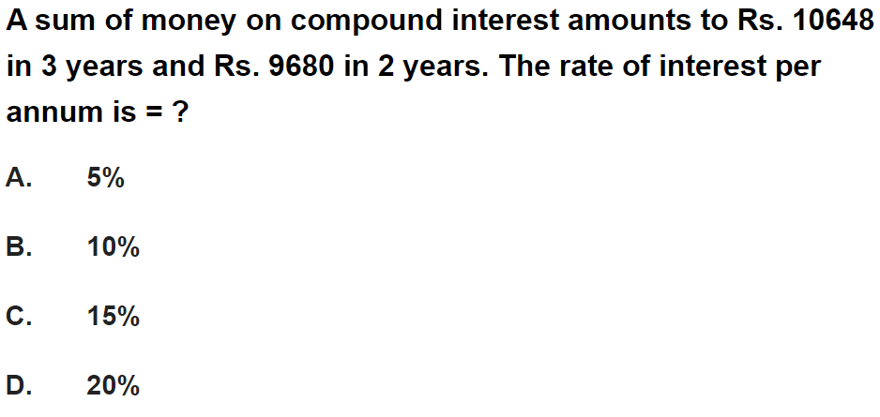
Question No. - 8

Slide 23
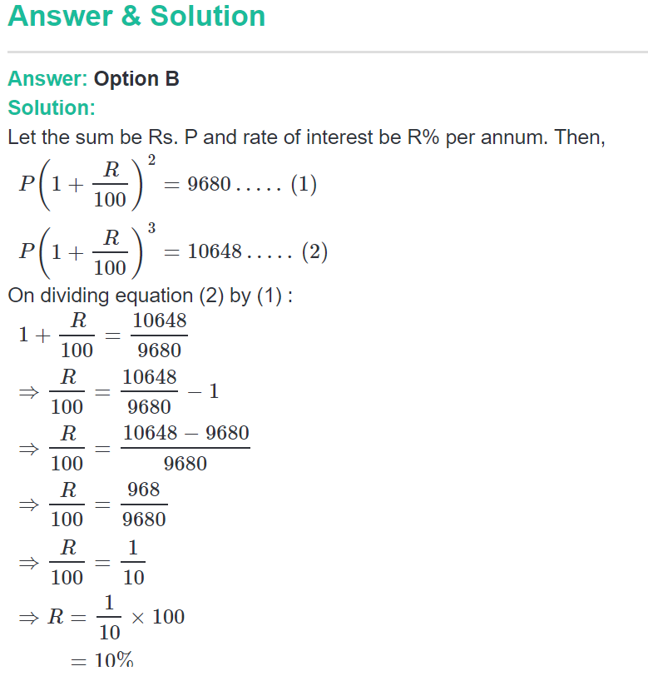

Slide 24
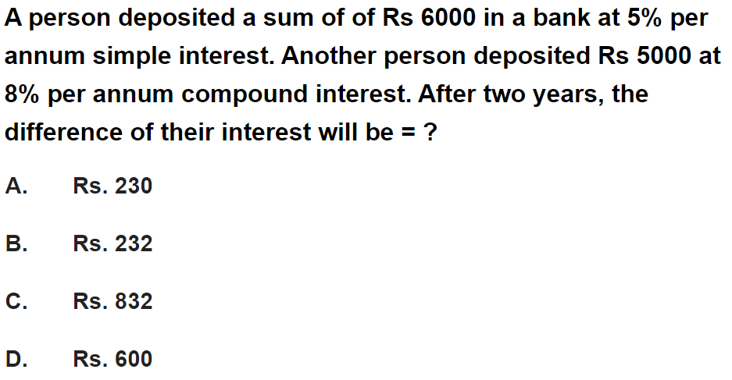
Question No. - 9

Slide 25
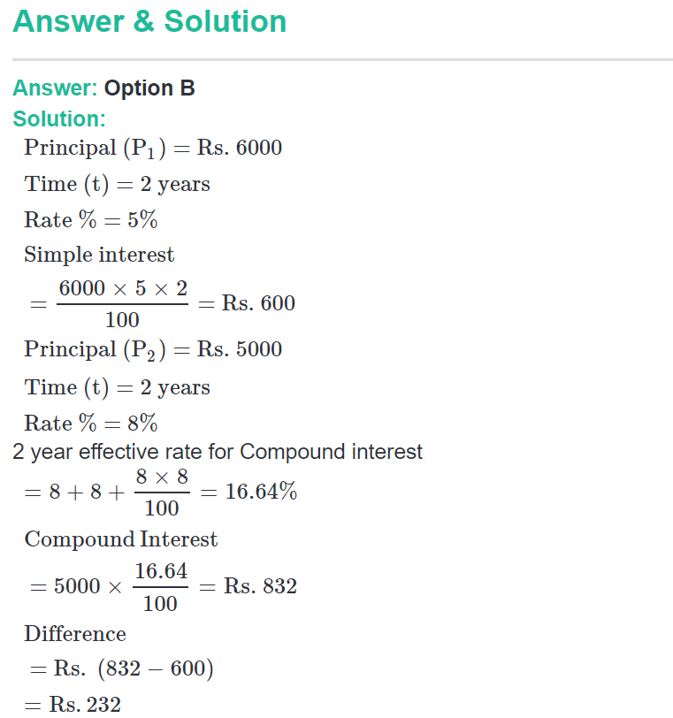

Slide 26
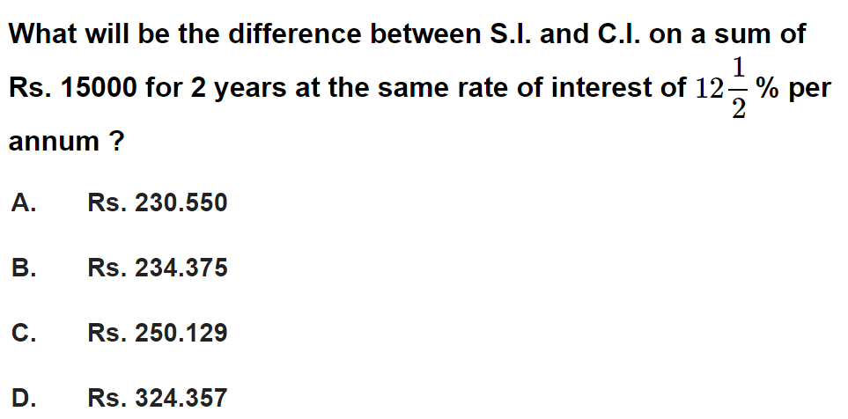
Question No. - 10

Slide 27
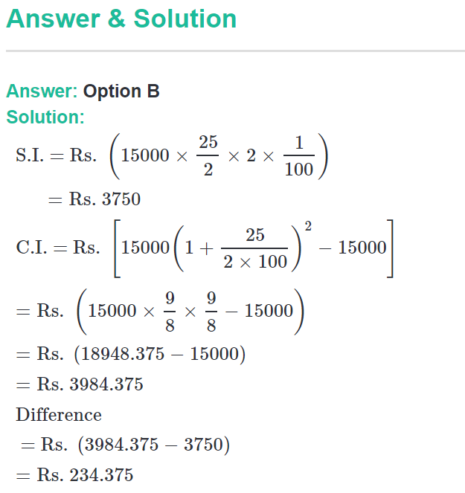

Slide 28
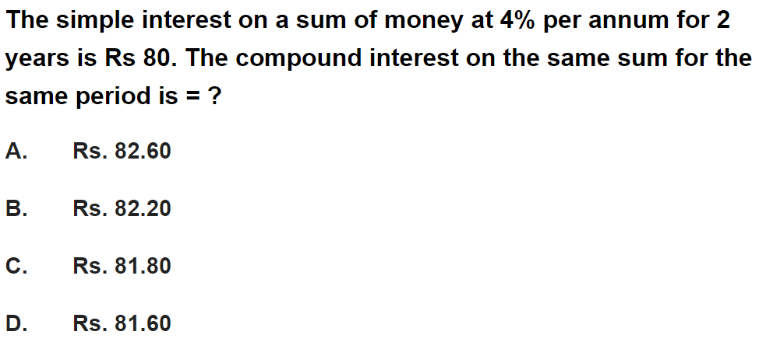
Question No. - 11

Slide 29
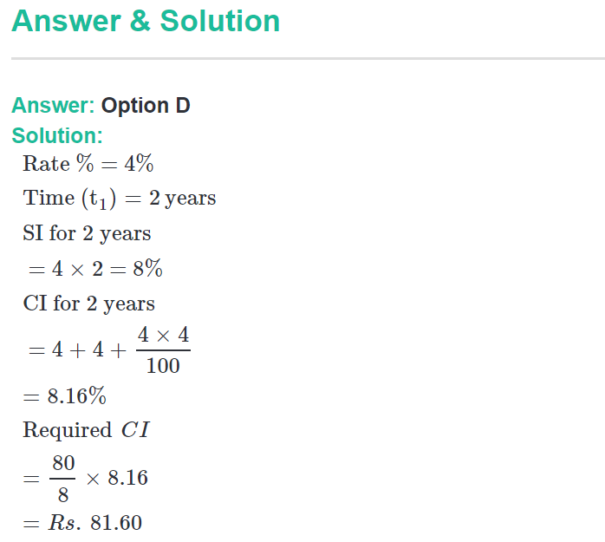

Slide 30
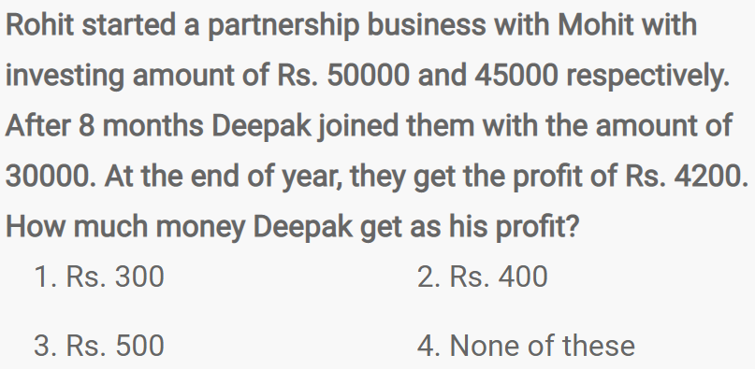
Question No. - 12

Slide 31
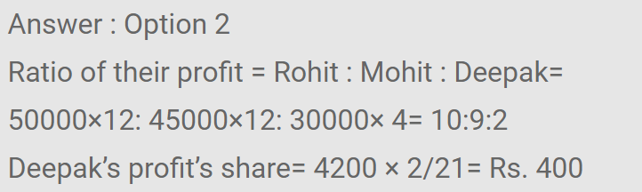

Slide 32
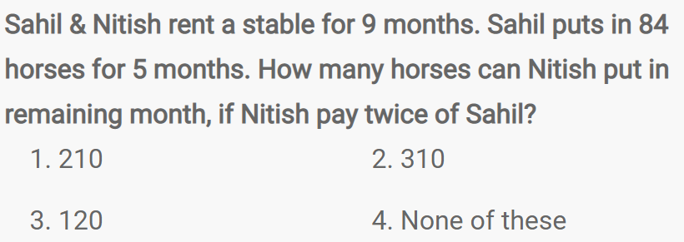
Question No. - 13

Slide 33
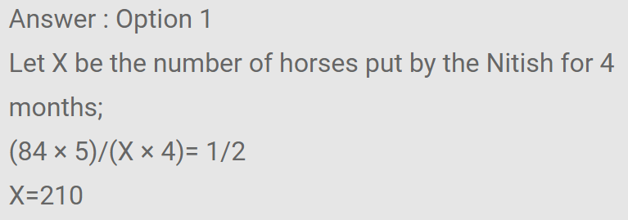

Slide 34
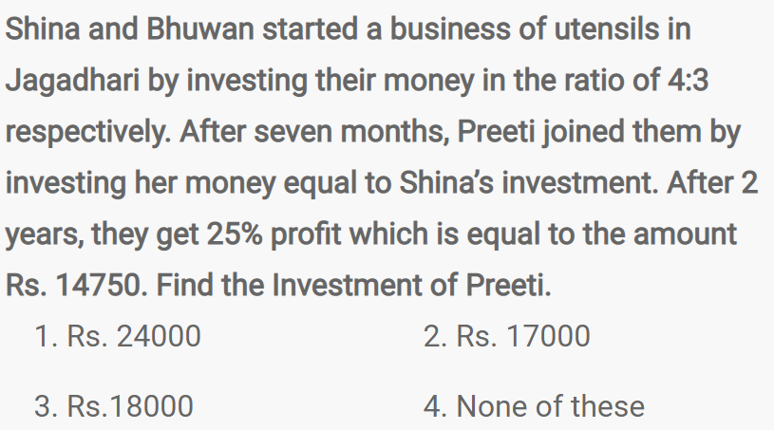
Question No. - 14

Slide 35
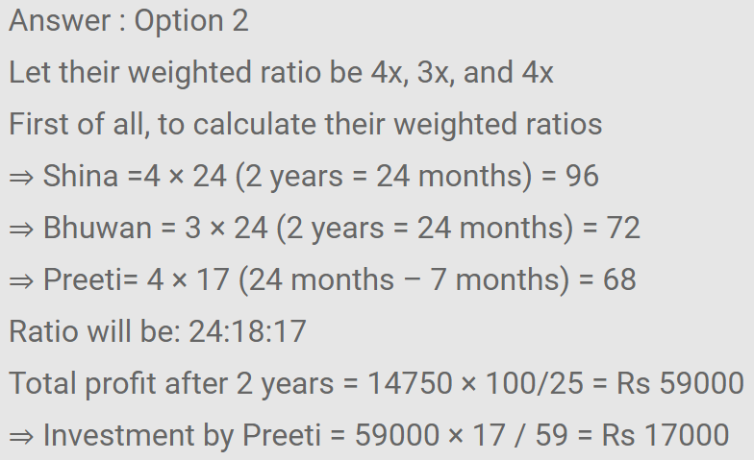

Slide 36
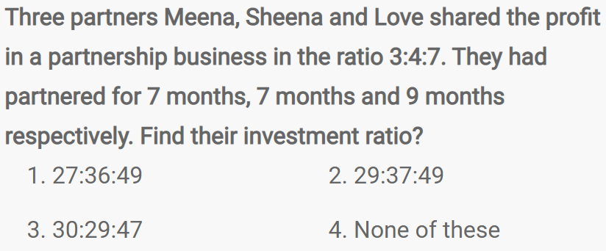
Question No. - 15

Slide 37
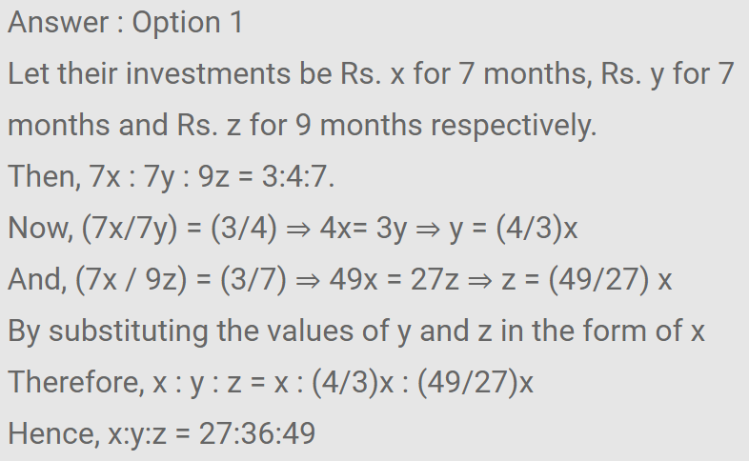

Slide 38
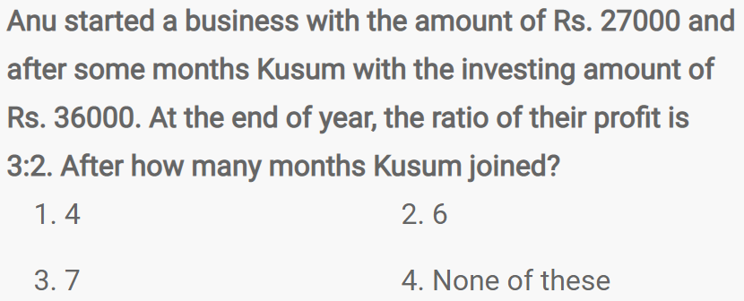
Question No. - 16

Slide 39
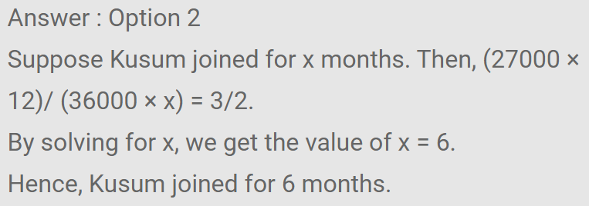

Slide 40
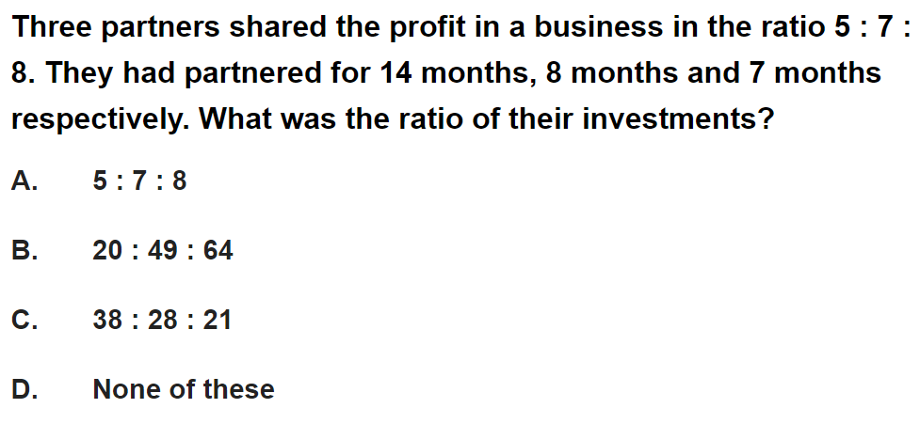
Question No. - 17

Slide 41
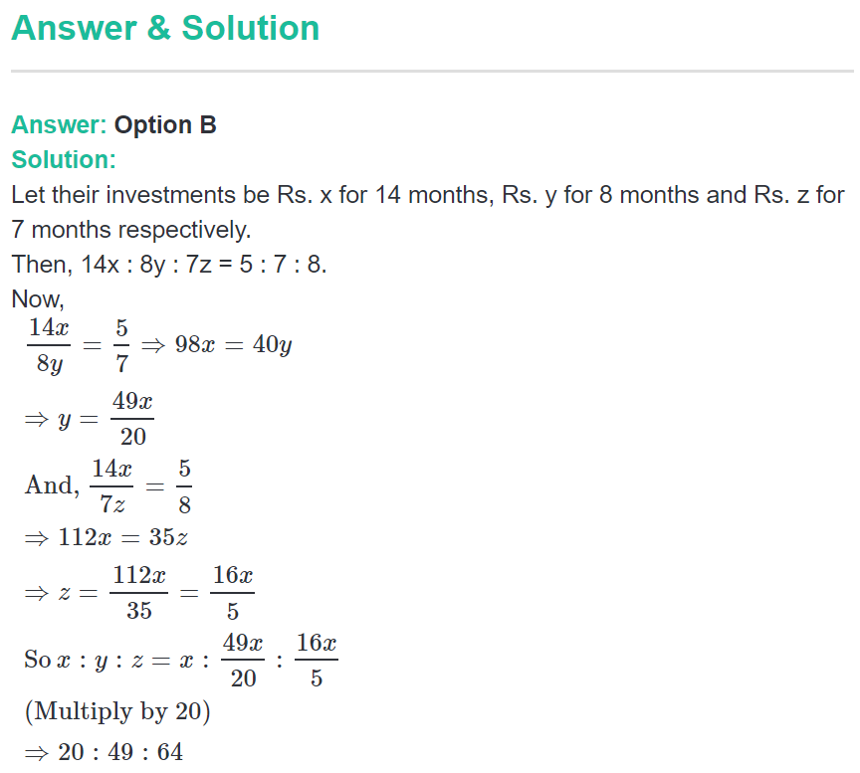

Slide 42
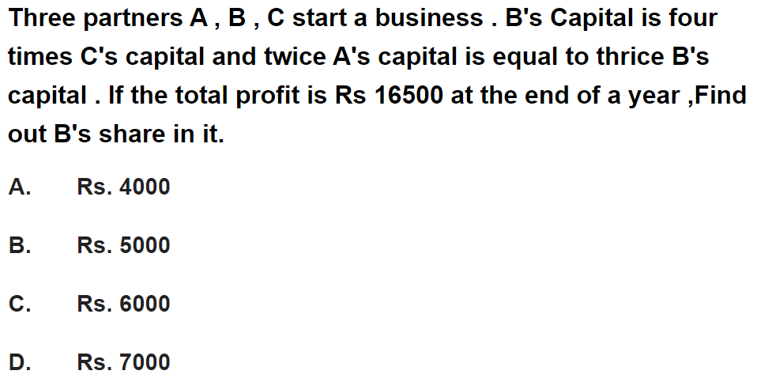
Question No. - 18

Slide 43
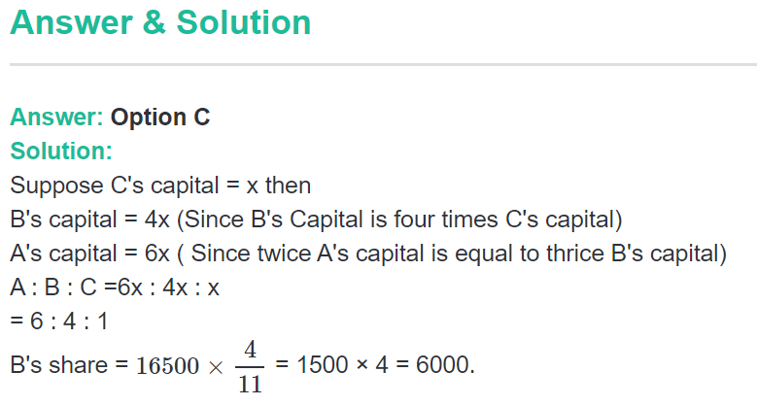

Slide 44
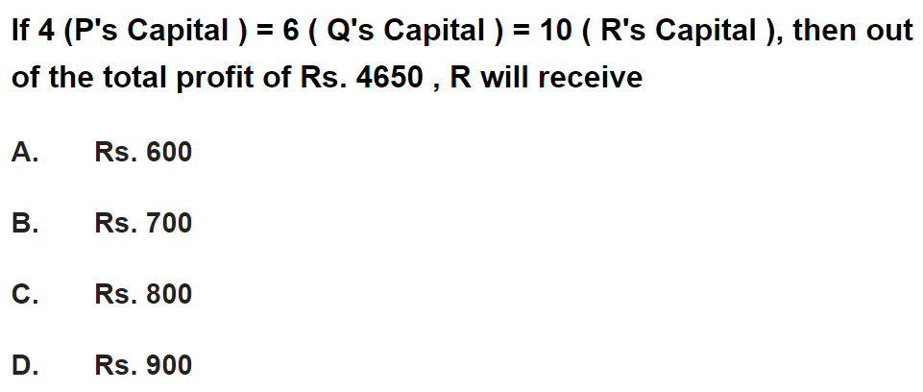
Question No. - 19

Slide 45
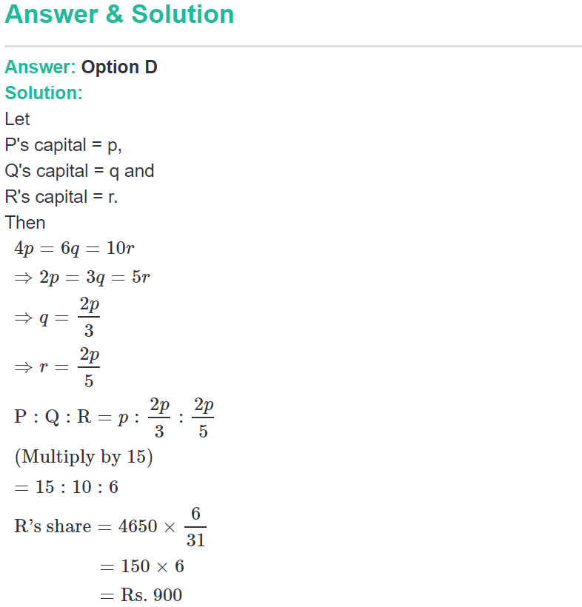

Slide 46
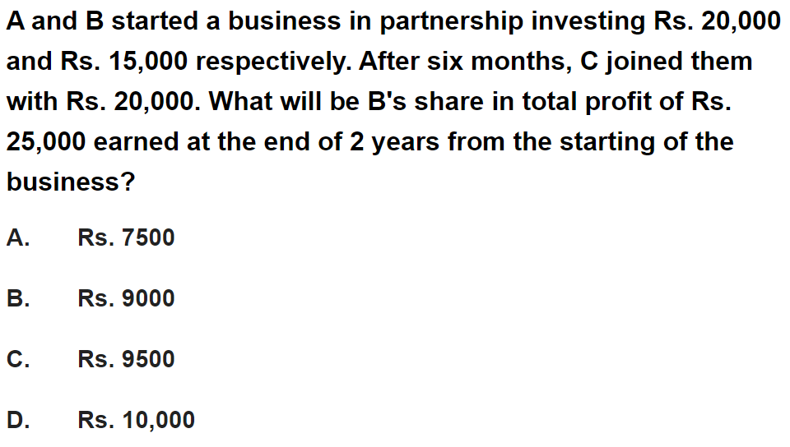
Question No. - 20

Slide 47
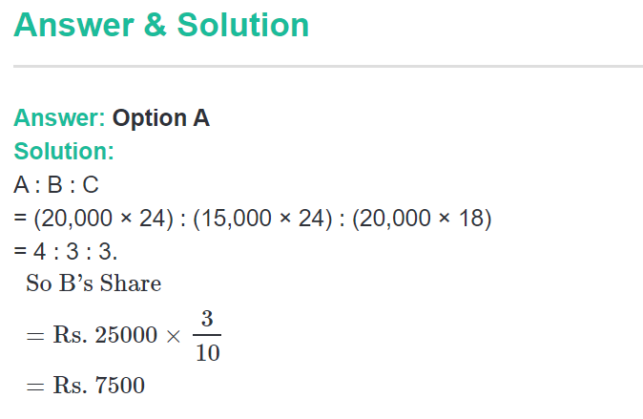

Slide 48
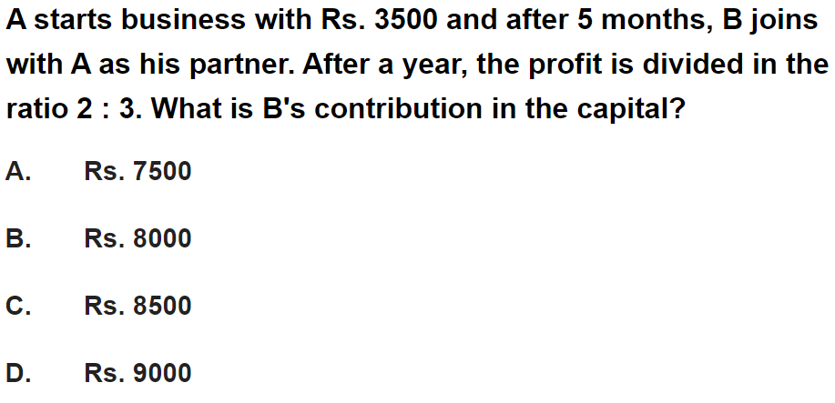
Question No. - 21

Slide 49
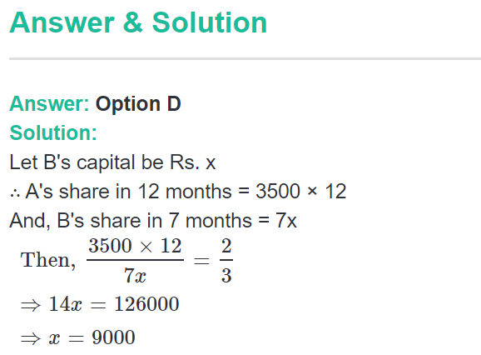

Slide 50
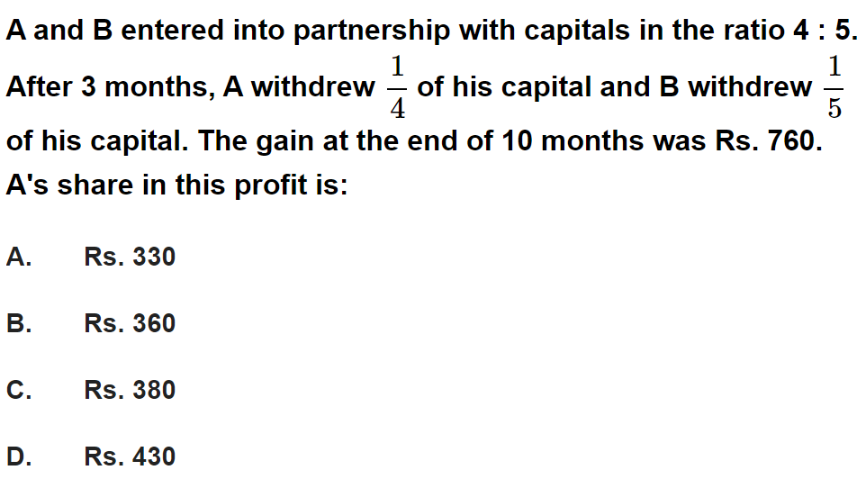
Question No. - 22

Slide 51


Slide 52

Question No. - 23

Slide 53


Slide 54

Question No. - 24

Slide 55


Slide 56

Question No. - 25

Slide 57


Slide 58

Question No. - 26

Slide 59


Slide 60

Question No. - 27

Slide 61


Slide 62

Question No. - 28

Slide 63


Slide 64

Question No. - 29

Slide 65


Slide 66

Question No. - 30

Slide 67


Slide 68

Question No. - 31

Slide 69


Slide 70

Question No. - 32

Slide 71


Slide 72

Question No. - 33

Slide 73


Slide 74

Question No. - 34

Slide 75


Slide 76

Question No. - 35

Slide 77


Slide 78

Question No. - 36

Slide 79


Slide 80

Question No. - 37

Slide 81


Slide 82

Question No. - 38

Slide 83


Slide 84

Question No. - 39

Slide 85


Slide 86

Question No. - 40
22000
19000
23000
20000

Slide 87


